Slide 1
Genomic protocols
Course Director
Yoav Gilad
Human Genetics department
CLSC room 325C
Phone: 773-702-8507
Email: gilad@uchicago.edu
Teaching Assistant
Katie Rhodes: klrhodes@uchicago.edu
Lecturer
Sebastian Pott: spott@uchicago.edu

Slide 2
Many applications of NGS protocols and assays
Notes:
Can locate histones in the genome
Epigenetic marks
Sequences of TF binding (Chip-seq)
RNAseq

Slide 3
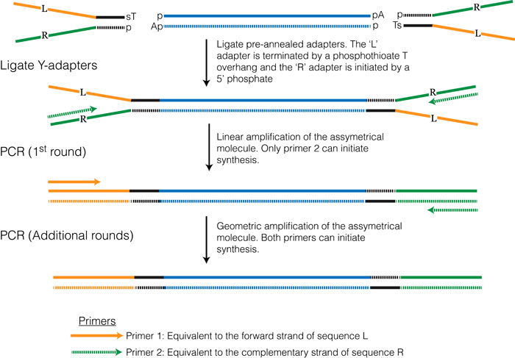
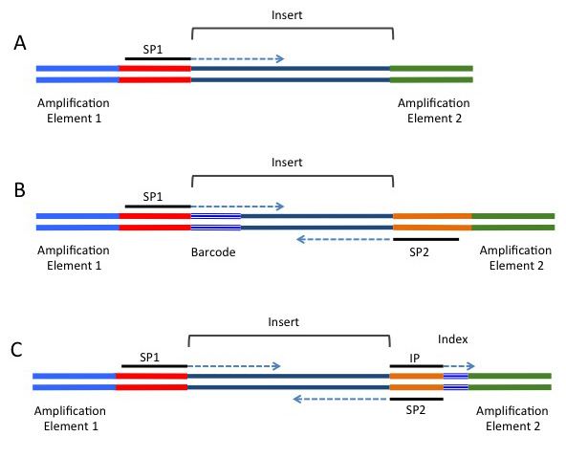
Standard libraries for Illumina sequencing
From: http://rnaseq.uoregon.edu
Notes:
Fragments of 200-1000 bp long
Attach adapters (on the image, these are the y-shaped)
The ends are not complementary, and this allows you to determine “read 1” or read 2 to distinguish As from s and have equal amounts of each in your population
Instead of annealing, you can use transposases

Slide 4
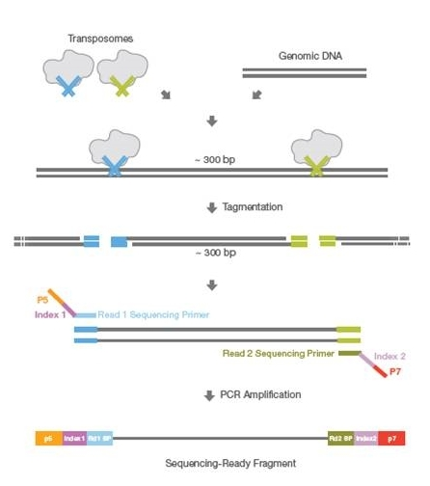
Alternative: Tagmentation based preparation of sequencing libraries
Illumina
Notes:
Allows the oligos to randomly integrate into the DNA
More of the transposomes = smaller pieces of DNA fragmented?

Slide 5
Outline
Detection and quantification of transcripts (RNA-seq)
Genome-wide measurement of Protein-DNA interactions (ChIP-seq)
Chromatin accessibility (DNase-seq, ATAC-seq)
Nucleosome occupancy (MNase-seq)
3D structure of the genome/genome folding (Hi-C)
DNA methylation (Bisulfite sequencing)

Slide 6
Similarities between workflows for next-gen sequencing
Of the nucleic acids
Shendure and Lieberman-Aiden, 2012

Slide 7
RNA-seq
Measure and quantify transcript levels
Identify novel transcripts and alternative splice variants or stop sites
http://rnaseq.uoregon.edu
Trapnell, 2012

Slide 8
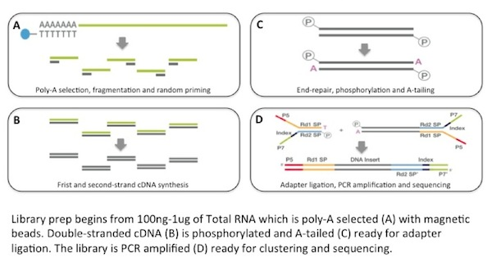
Basic RNA-seq protocol
Alternative polyA selection?
Alternatives to this protocol?
Illumina (via bitesizebio)
Notes:
Most RNA is not mRNA but is ribosomal RNA (like 90%)
How to leave out rRNA?
Enrich for by capturing the mRNA with the polyA tail.
Alternatives: selectively degrade rRNA, have the sequence specific to the polyA tail (not ideal) b/c the polymerase will fall off of the strand

Slide 9
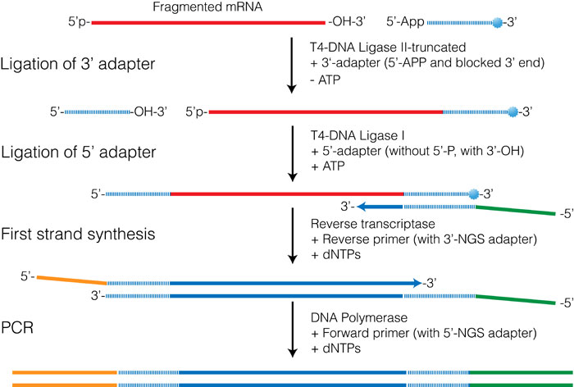
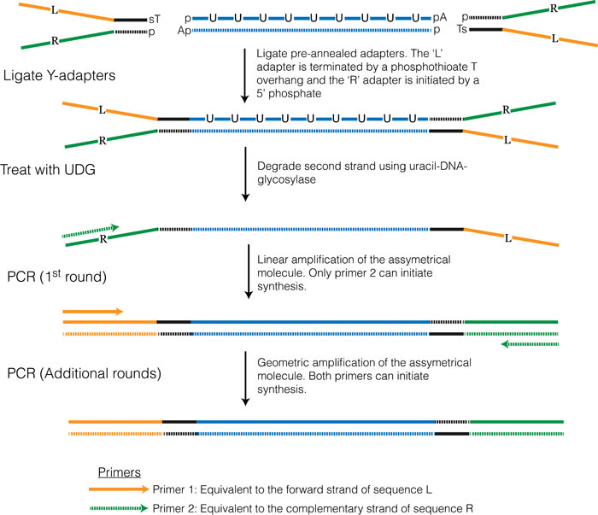
Strand-specific RNA-seq protocols
Alternative:
Polymerase that
Cannot read Uracil
http://rnaseq.uoregon.edu
Notes:
Key idea: only transcribes a certain portion b/c it won’t amplify sequences with uracil
Alternative: degrade the strand with uracil-DNA-glycosylase

Slide 10
What you want to detect will determine which protocols to use
mRNAs
All RNAs
Small RNAs
Alternative protocols?

Slide 11
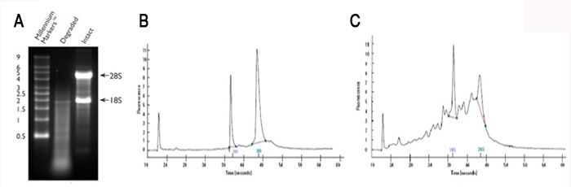
Challenges working with RNA
RNA is much less stable than DNA
RNases are present in cells and environment
Important to Assess RNA quality before library prep
Schroeder et al. 2006
Notes:
RIN score should be above 8

Slide 12
What can affect the outcome of RNA-seq experiments?
Tissue sample vs. cell lines
Collection of samples from tissues (specific regions)
Tissue composition (e.g. cancer vs normal or inflamed vs healthy)
Differences in library preparation
Fragment lengths
Notes:
Problems of RNA isolation from tissues:
Tissue heterogeneity based on different cells in sample, tissue samples aren’t fresh,
Ex. lower RNA quality = lower reads and possibly less shearing = bias

Slide 13
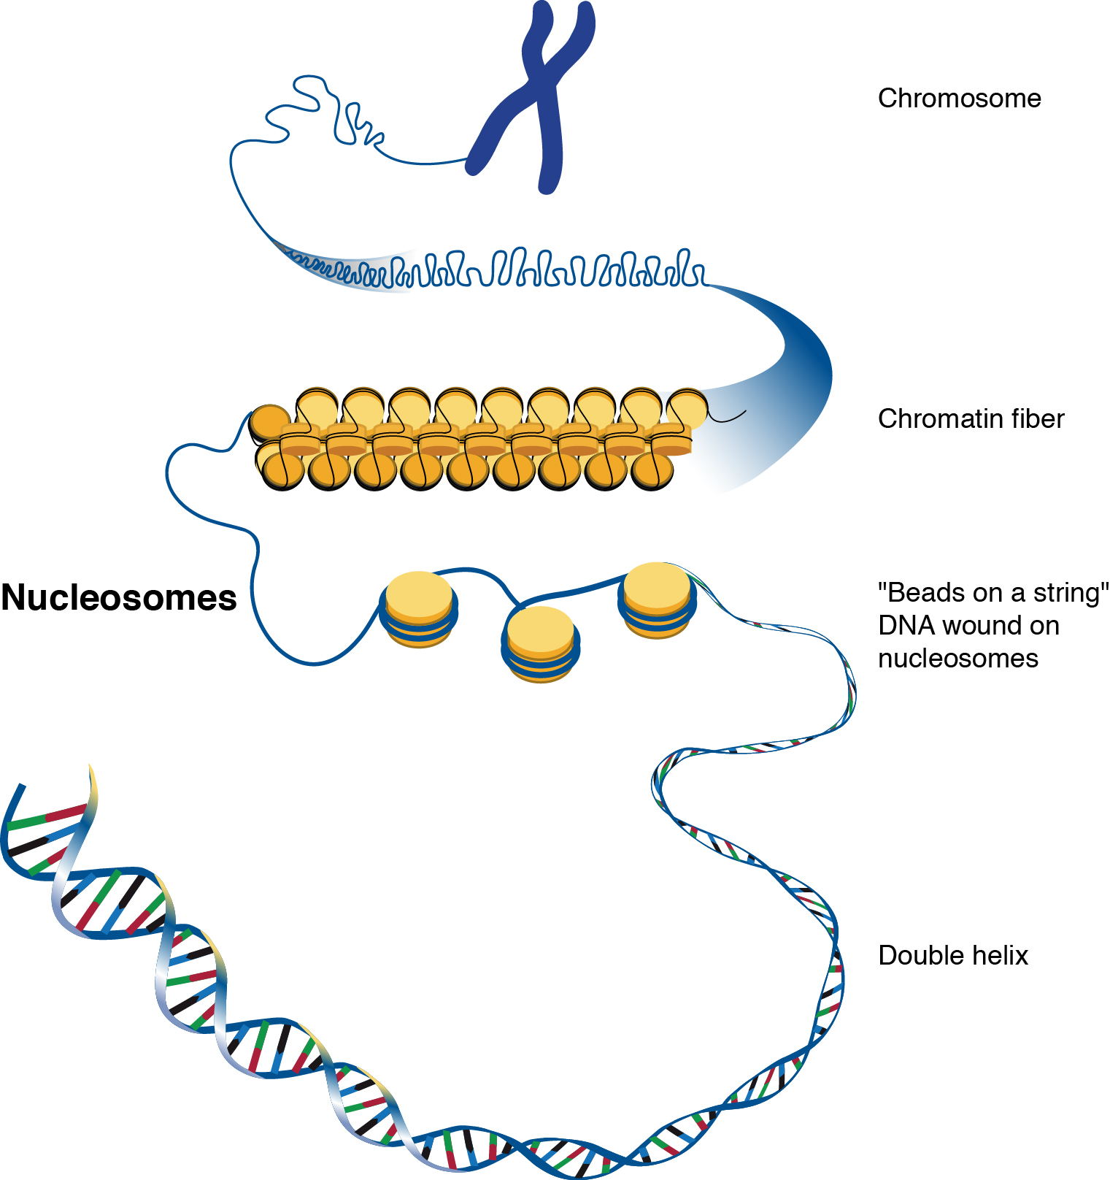
How and when is the regulatory information encoded in the genome utilized?
from NHGRI genome.gov
Notes:
Change this to the typical ‘epigenomic opening slide’
-this is my interest:
- The human genome sequence led to an appreciation

Slide 14
Which regions are occupied by regulatory factors?
Shlyueva et al. PMID: 24614317

Slide 15
ChIP-seq identifies DNA-protein interactions
Shlyueva et al. PMID: 24614317
Notes:
Doesn’t prove direct or indirect binding

Slide 16
ChIP-seq workflow
Step 1
Step 2
Step 3
Step 4
Notes:
**crosslink as soon as possible**
100-500 bp

Slide 17
Chip-seq library QC with bioanalyzer
Notes:
Should have fragment size you want ex. the 200 bp
Adapter dimer will use up resources needed to amplify the DNA properly :. Wasting money and limiting reading ability

Slide 18
What kind of signal do we expect?
Park, Nat .Rev. Gen. 2009
Notes:
Well-definied = strong and narrow peaks

Slide 19
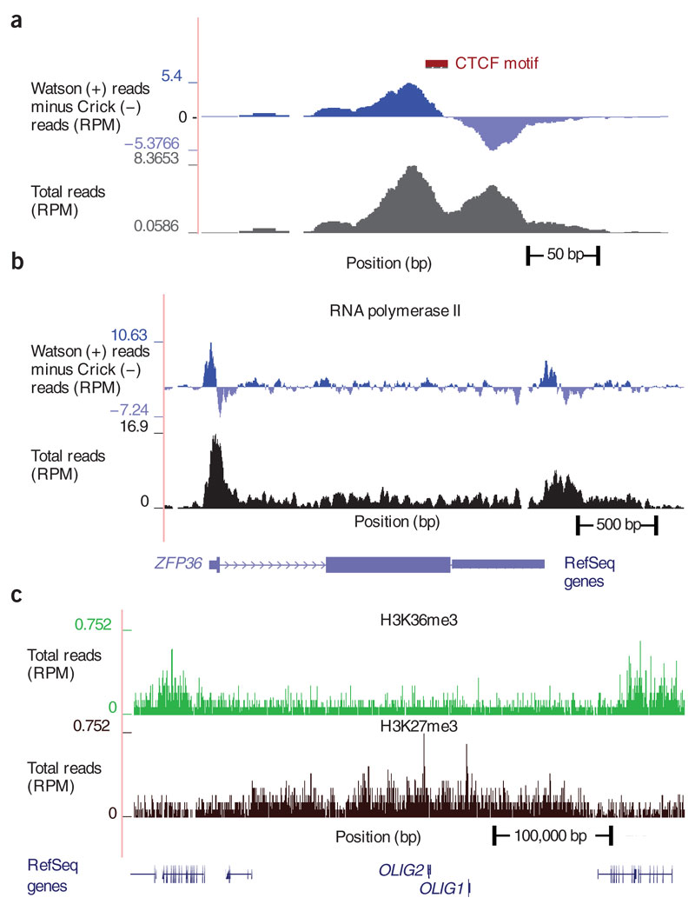
How do ChIP-seq reads align to the genome?
(Pepke, Nat. Methods, 2009)
Considerations for single-end reads
Park, Nat .Rev. Gen. 2009

Slide 20
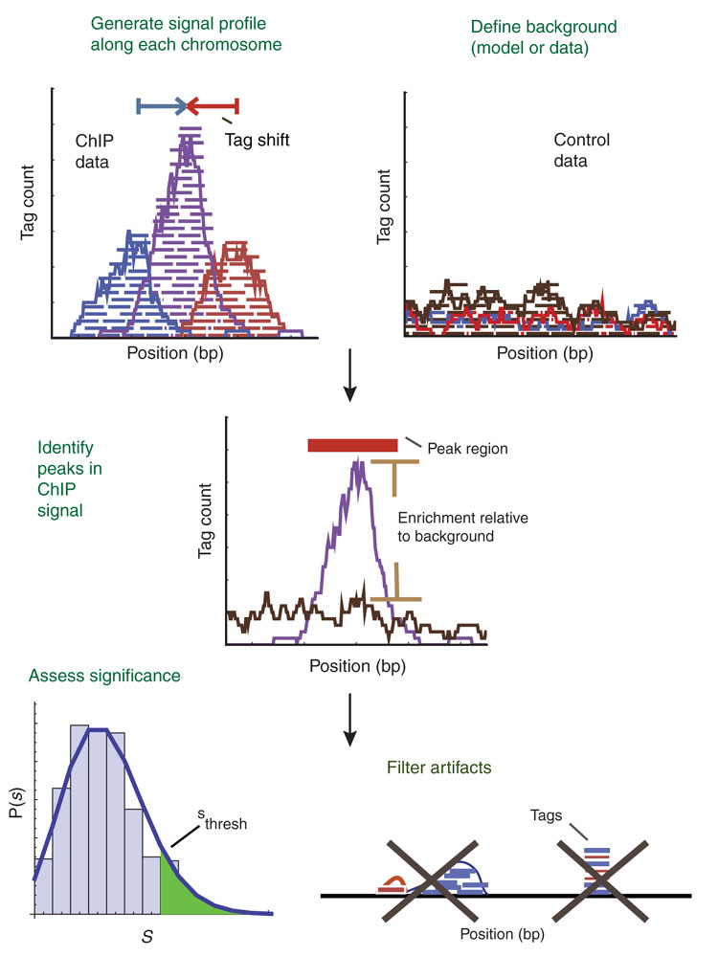
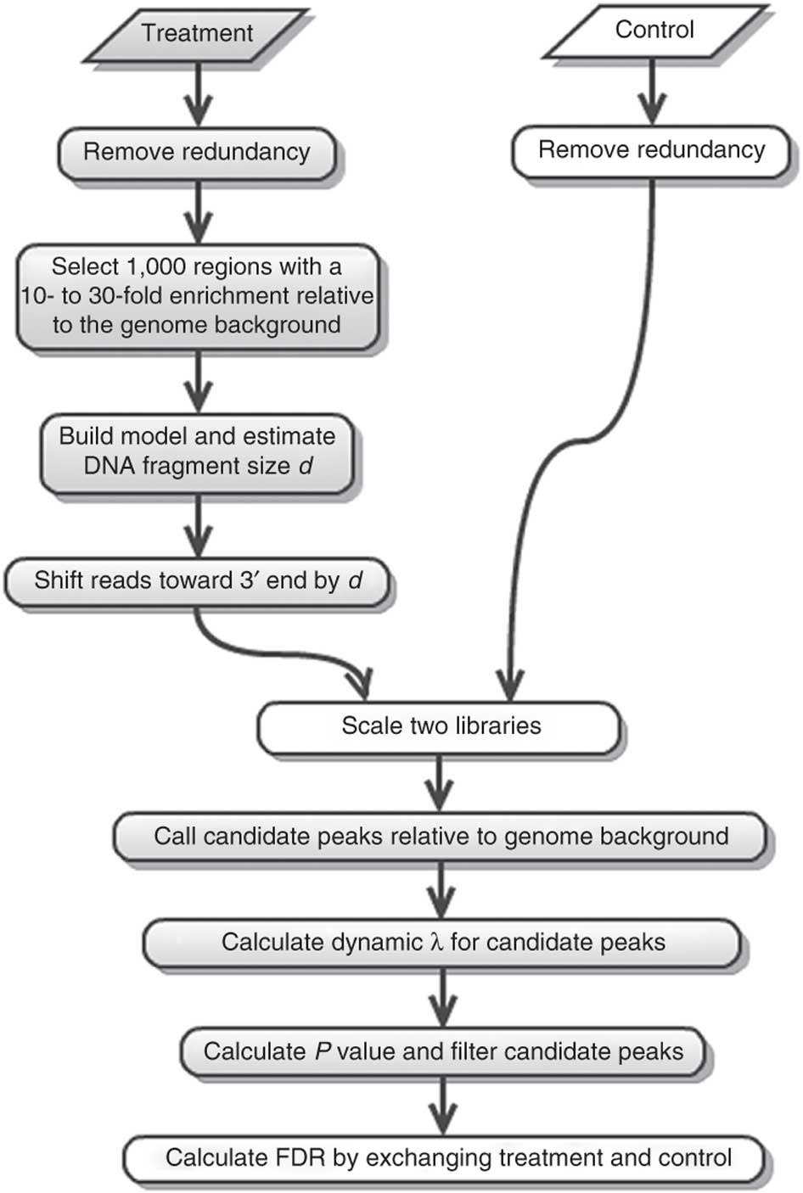
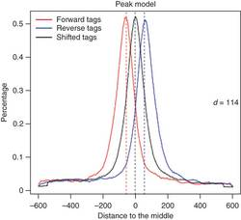
Identification of significantly enriched regions-Peak calling
Model-based analysis of ChIP-seq (MACS)
(Zhang, Gen. Biol., 2008)
(Feng, Nat. Protoc., 2012)
(Pepke, Nat. Methods, 2009)

Slide 21
ChIP-seq challenges
Step 1
Sample composition
Sample homogenization
Cross-linking vs. native native ChIP
Fragmentation: Sonication/MNase- digestion
Antibody availability and quality
Step 2
Step 3
Step 4
Notes:
When crosslinking tissues, cells will get exposed at different time points due to penetrance
Native-CHIP can work sometimes with TF and epigenetic modifications on the histones
Mnase digestion can be used to break down the genome into single nucleosome units, biggest issue is the affinity and specificity of the antibody
To prove specificity, use multiple antibodies and show it is repeatable, and also have a negative control

Slide 22
Modifications of the ChIP-seq protocol to increase the resolution
Zentner and Henikoff, 2014
Notes:
Use a nuclease that digests free/unbound DNA

Slide 23
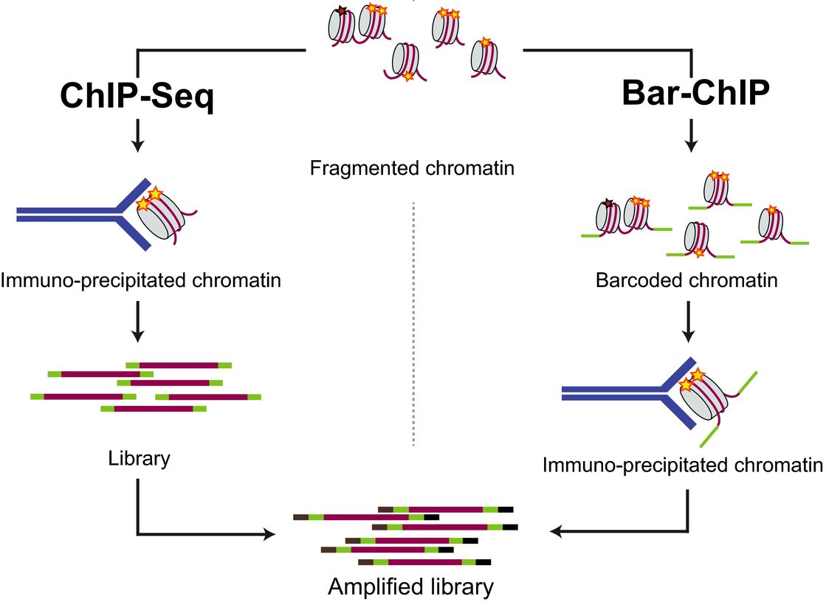
Barcoding chromatin samples to control for variation during immuno-precipitation
Christophe D Chabbert et al. Mol Syst Biol 2015;11:777
Notes:
Controls for variation b/c you can combine samples past a certain point

Slide 24
Global changes are difficult to detect with ChIP-seq
Orlando et al. 2014
Notes:
Seq is a “ratio” game, and even the entire genome shifts, then you won’t detect changes
Solution: spike-in samples

Slide 25
Chromatin spike-ins
Orlando et al. 2014
Notes:
To make it quantitative instead of ratio, use the spike-in which stands for a certain # of cells
******IMPROVEMENT ON THE CELL METHOD::USE TOTAL DNA INSTEAD OF CELL NUMBER TO NORMALIZE, THIS DOES NOT GET SCREWED UP BY ANUEPLOIDY

Slide 26
Open chromatin assays
Identification of putative regulatory elements
Transcription factor footprints
Unbiased (compared to ChIP-seq)
Chromatin acts as a barrier for transcription factor binding at regulatory elements
Shlyueva et al. PMID: 24614317

Slide 27
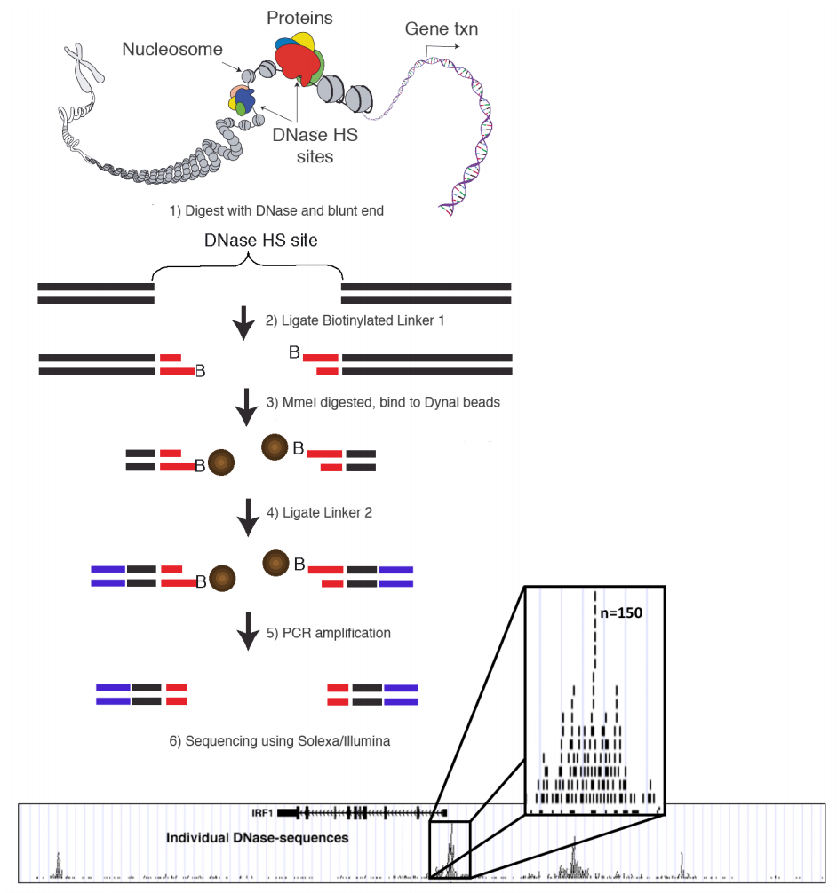
DNase-seq
Furey, 2012
(Song and Crawford, Gen. Res., 2010)
Notes:
Fragments are long to be begin with = can’t sequence them
MME1 cuts every 19 bp

Slide 28
DNase-seq reveals cell-type-specific chromatin accessibility patterns

Slide 29
Transcription factor footprints are apparent from DNase-seq data
Neph et al. 2012, Nature

Slide 30
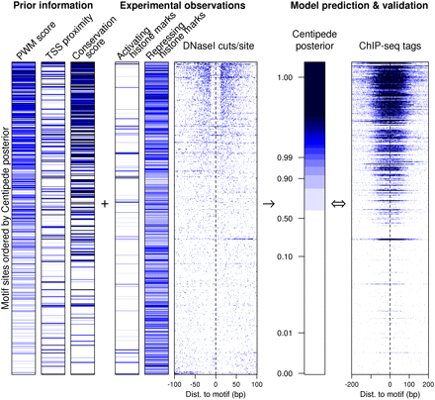
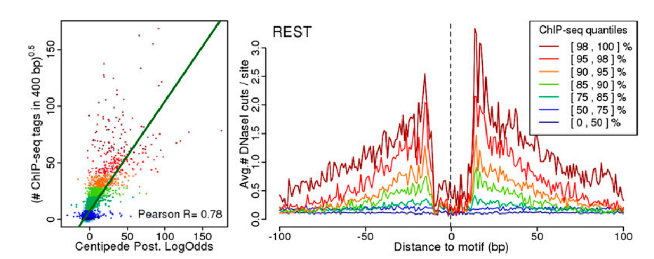
CENTIPEDE: infer TF binding in DNase-seq data
Accurate inference of transcription factor binding from DNA sequence and chromatin accessibility data
(Pique-Regi/Degner, Gen. Res., 2011)

Slide 31
Alternative strategy to get accessible chromatin data: ATAC-seq
(Illumina)
ATAC-Seq: Assay for Transposase-Accessible Chromatin using sequencing
(Buenrostro, Nat. Methods, 2013 )

Slide 32
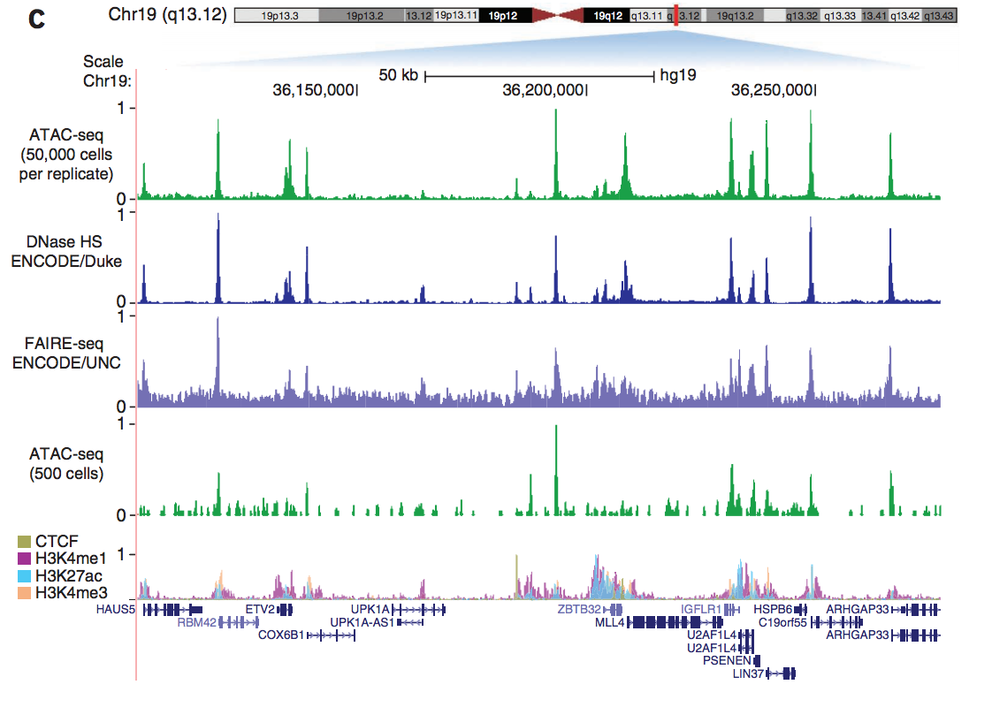
ATAC-seq identifies regions of open chromatin
(Buenrostro, Nat. Methods, 2013 )

Slide 33
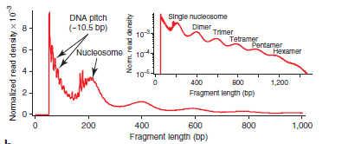
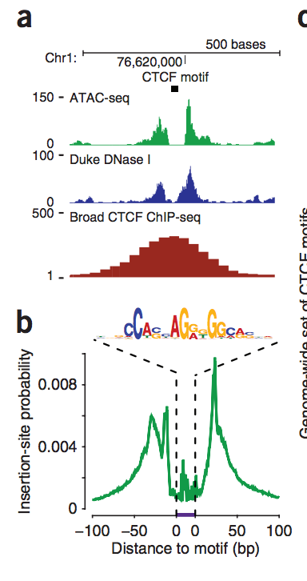
ATAC-seq detects nucleosomes and footprints of TF binding
corresponding
fragment lengths
(Buenrostro, Nat. Methods, 2013 )

Slide 34
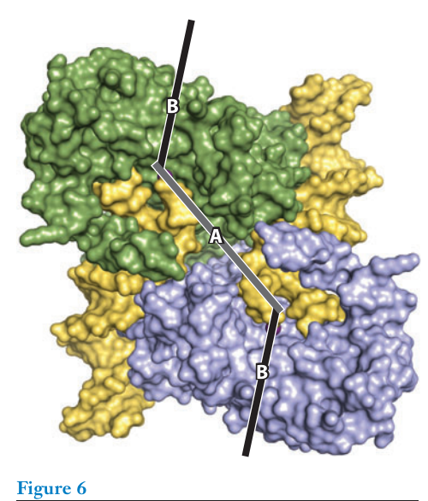
“Activated” Tn5 transposase dimer with sequencing adaptors
5’
Tn5ME-A adaptor
Target DNA
5’
3’
3’
Tn5 transposase 2
-OH
:
:
Tn5 transposase 1
-OH
Target DNA
3’
3’
Tn5ME-B adaptor
5’
5’
Reznikoff, W. S. (2008). Annual Review of Genetics
Slide by Kohta Ikegami

Slide 35
Insertion mechanism creates 9 bp off-set between plus and minus strand
5’
Target DNA
Tn5ME-A adaptor
5’
3’
3’
-OH
Tn5 transposase 2
:
*********
Tn5 transposase 1
:
^^^^^^^^^
(9 bp)
-OH
3’
Tn5ME-B adaptor
3’
5’
5’
Sequencing fragment A
5’
3’
5’
3’
5’
3’
^^^^^^^^^
9 bp
5’
*********
3’
3’
3’
5’
5’
Sequencing fragment B
Reads should be offset by +4 bp for the +strand and −5 bp for the −strand
Slide by Kohta Ikegami

Slide 36
ATAC-seq challenges
High levels of mitochondria sequences in libraries
Cell lysis (and nuclei lysis)
Notes:
Up to 60%
Can deplete mitochondrial reads

Slide 37
MNase-seq: Nucleosome positions and phases
Jeffers et al., GR, 2016

Slide 38
How is the genome organized in space?
Lieberman-Aiden, Science, 2009

Slide 39
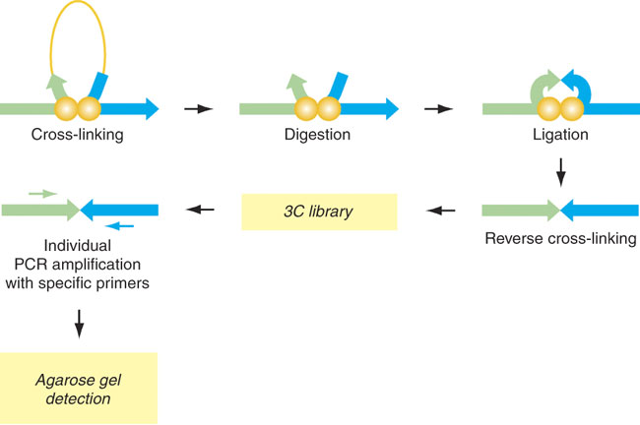
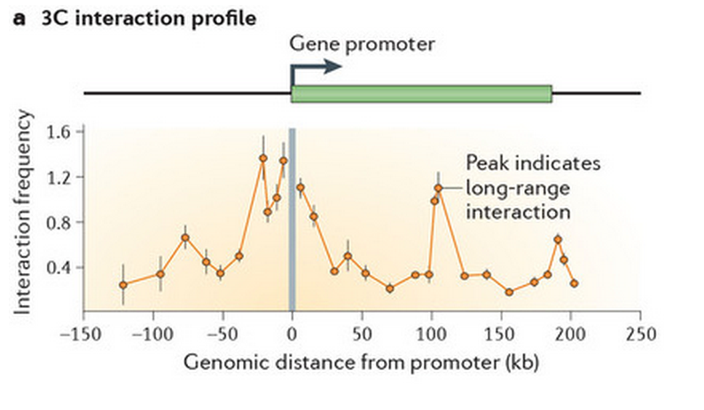
Chromosome conformation capture (3C)
(Dostie, Nat. Gen., 2007)
(Dekker, Nat. Rev. Gen, 2013 )
Notes:
Higher peak = these areas are linked to creating the 3d structure

Slide 40
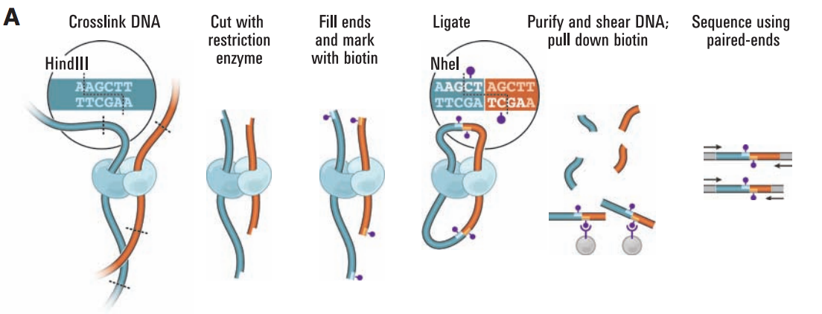
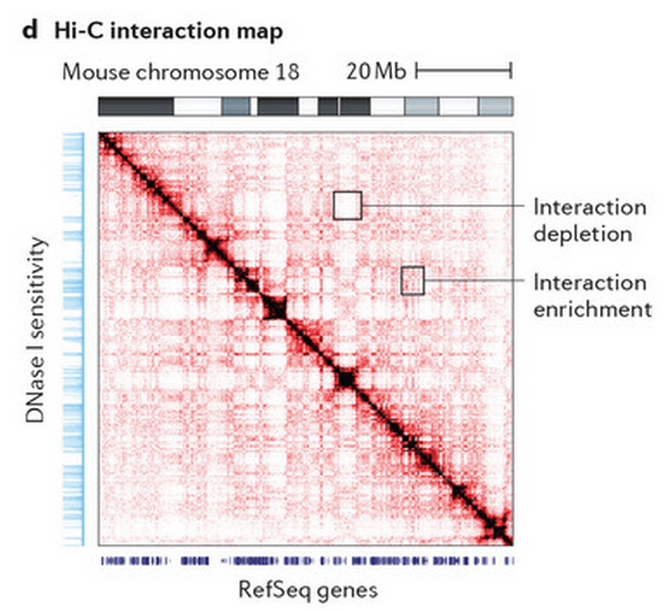
Hi-C allows unbiased identification of chromatin interactions genome-wide
(Lieberman-Aiden , Science, 2009)
(Dekker, Nat. Rev. Gen., 2013)

Slide 41
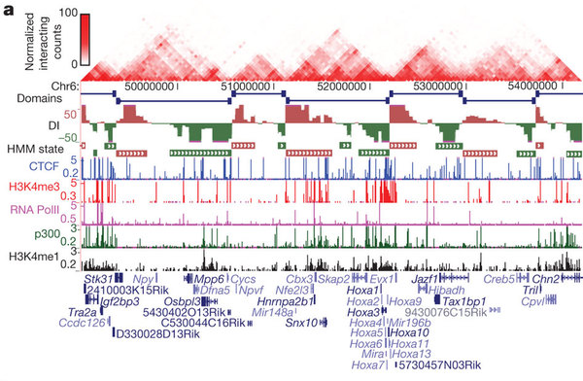
Chromatin interactions identify topological domains (TADs)
(Dixon, Nature, 2012)

Slide 42
Risca and Greenleaf, 2015

Slide 43
DNA methylation sequencing

Slide 44
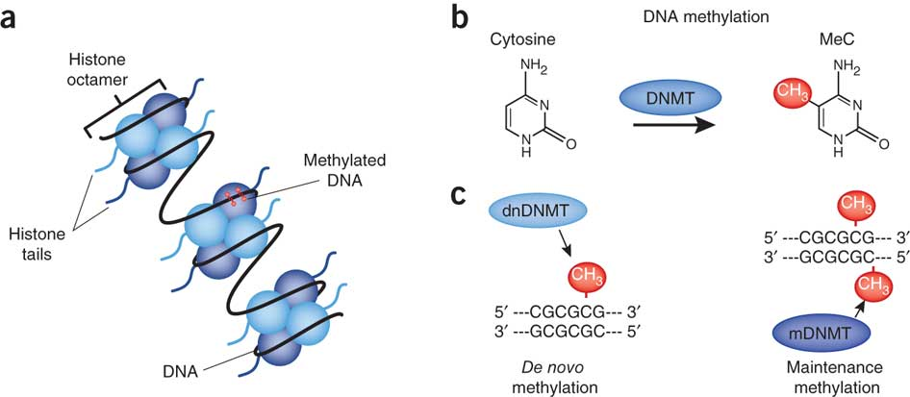
Cytosine methylation is a covalent modification of DNA – ‘epigenetic modification’
(Day, Nat. Neuro., 2010)

Slide 45
Different approaches to study DNA methylation
Bisulfite- Sequencing:
Whole genome bisulfite sequencing
(WGBS)
Reduced representation bisulfite sequencing
(RRBS)
Enrichment-based:
Methylated DNA Immunoprecipitation
(MeDIP-seq)

Slide 46
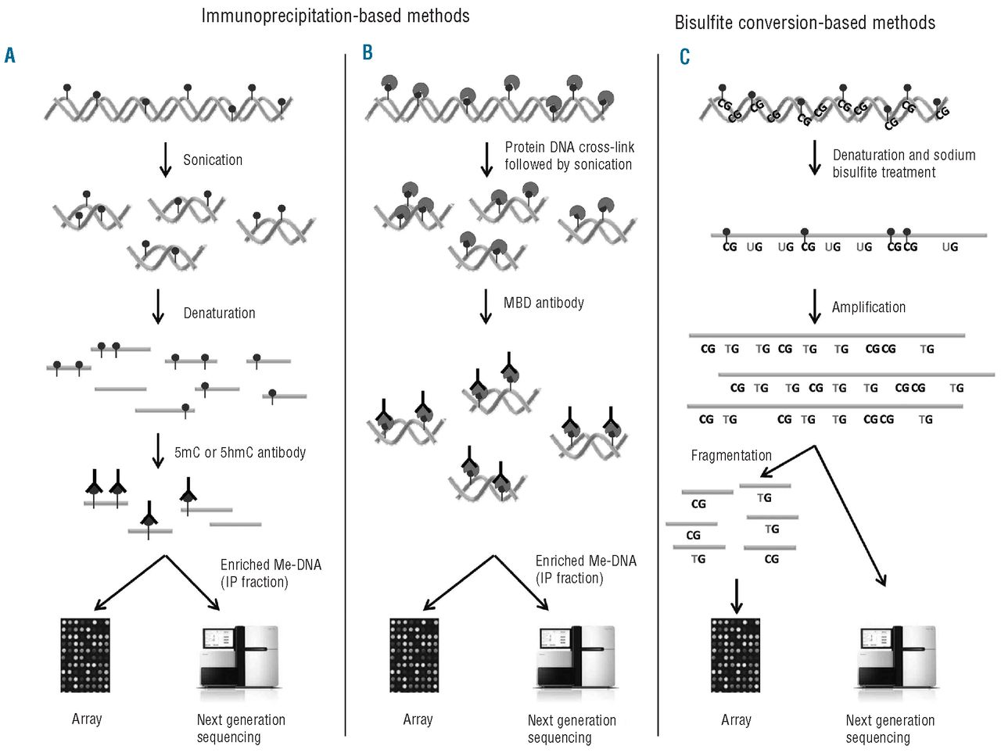

Methods to detect global DNA methylation
Kirsten Grønbæk et al. Haematologica 2012;97:1380-1388
Notes:
Methods to detect global DNA methylation. (A) Methylated DNA immunoprecipitation (MeDIP). DNA is sonicated and subsequently denatured. Single stranded DNA is incubated with antibodies against either methylated (5mC) or hydroxymethylated (5hmC) cytosines followed by IP. The IP fraction (enriched for either methylated DNA or hydroxymethylated DNA) can either be labeled and hybridized to whole-genome tiling arrays or analyzed using next generation sequencing (NGS). (B) Chromatin immunoprecipitation (ChIP) of methylated DNA. DNA and protein are cross-linked by formalin followed by sonication. DNA is incubated with antibodies or proteins that bind MBDs and precipitated. The enriched fraction can be analyzed by the same methods as for MeDIP. (C) The DNA is denatured and treated with sodium bisulfite. Unmethylated cytosine, ‘C’, is converted to uracil, ‘U’, while 5mC or 5hmC are unchanged. In the subsequent amplification, ‘U’ is amplified as thymine, ‘T’, while the unconverted 5mC or 5hmC are amplified as ‘C’. The amplification products are fragmented and hybridized to bead-based arrays or analyzed by NGS.

Slide 47
Bisulfite conversion
NEB

Slide 48
Specific considerations for alignment of bisulfite converted DNA
Potential challenges:
Conversion efficiency
Difficult to distinguish 5-mC and 5-hmC
Notes:
C -> U when NOT marked and then to a T
C stays the same = epigenetically marked with 5-mC or 5-hmC

